Slide 1
Fabric
An overview

Slide 3
Ze Plan
How to set it up
subscriptions,
rights,
quick management practices
How to access it
Upload sample data file
Show basic queries
Show basic reporting

Slide 4
Fabric Tenant creation

Slide 5
Requirements
Subscription with an Admin access
FDPO – does not work (June’23)
External tenant – works!
MS Visual Studio – works!
You will need M365 Developer
Remember to pause subscription

Slide 6
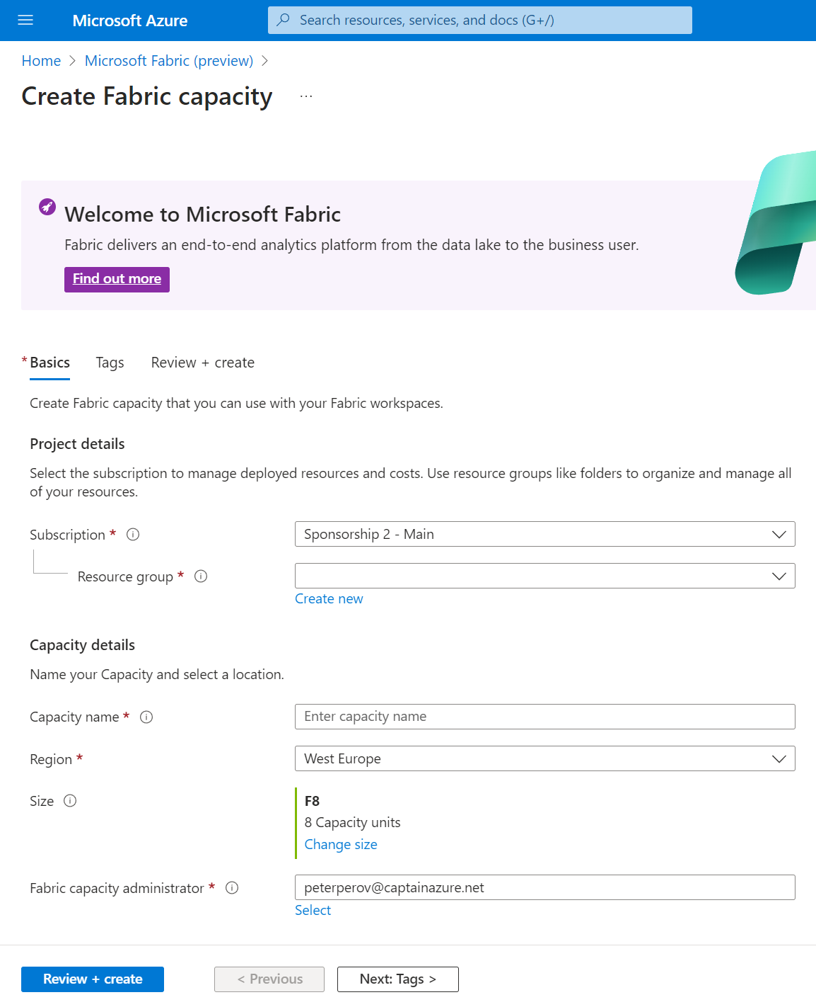
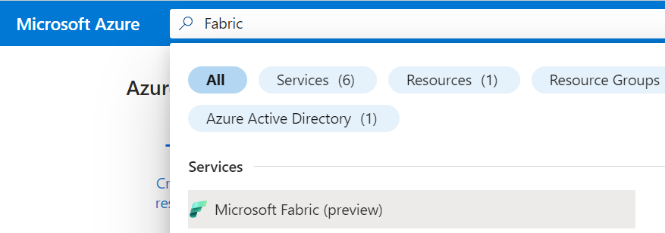
Fabric Creation
Create Capacity on Azure Portal

Slide 7
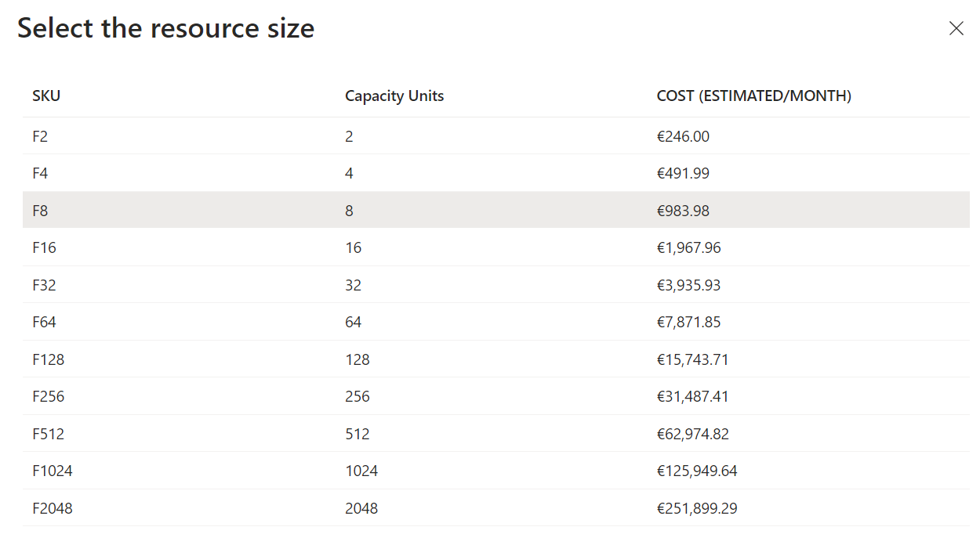
Choose Capacity (preview! June’23)
Notes:
PREVIEW PRICING, INDICATION ONLY

Slide 8
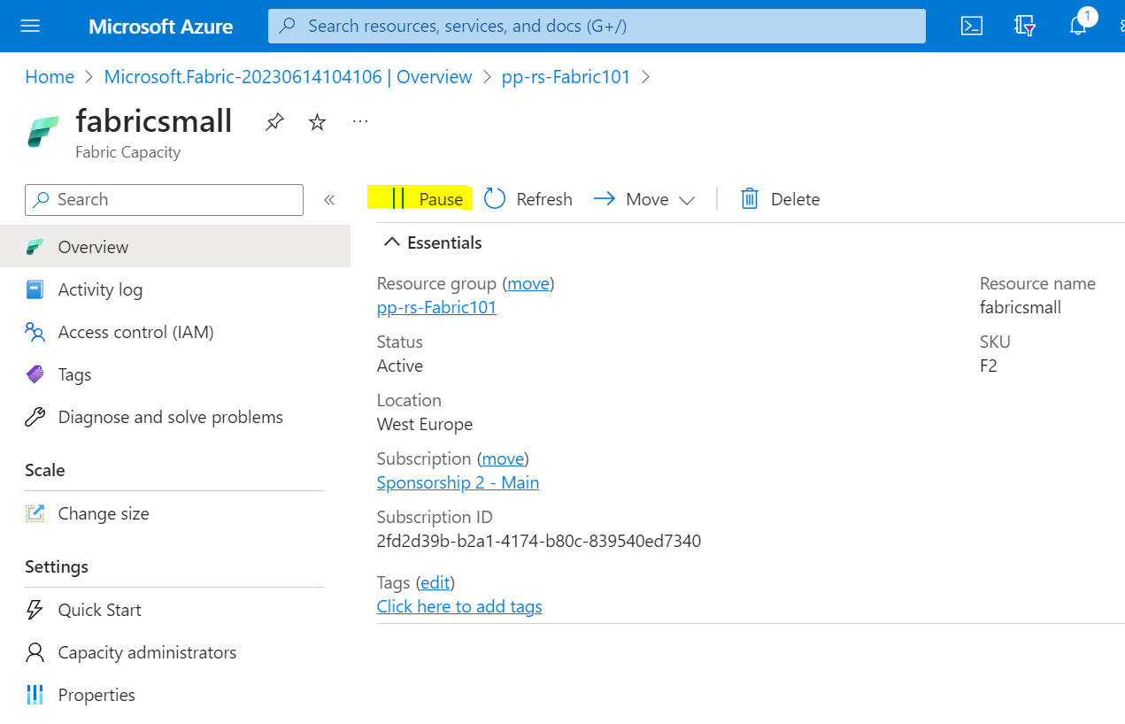
Capacity can be paused!
Notes:
Logic App to pause Capacity

Slide 9
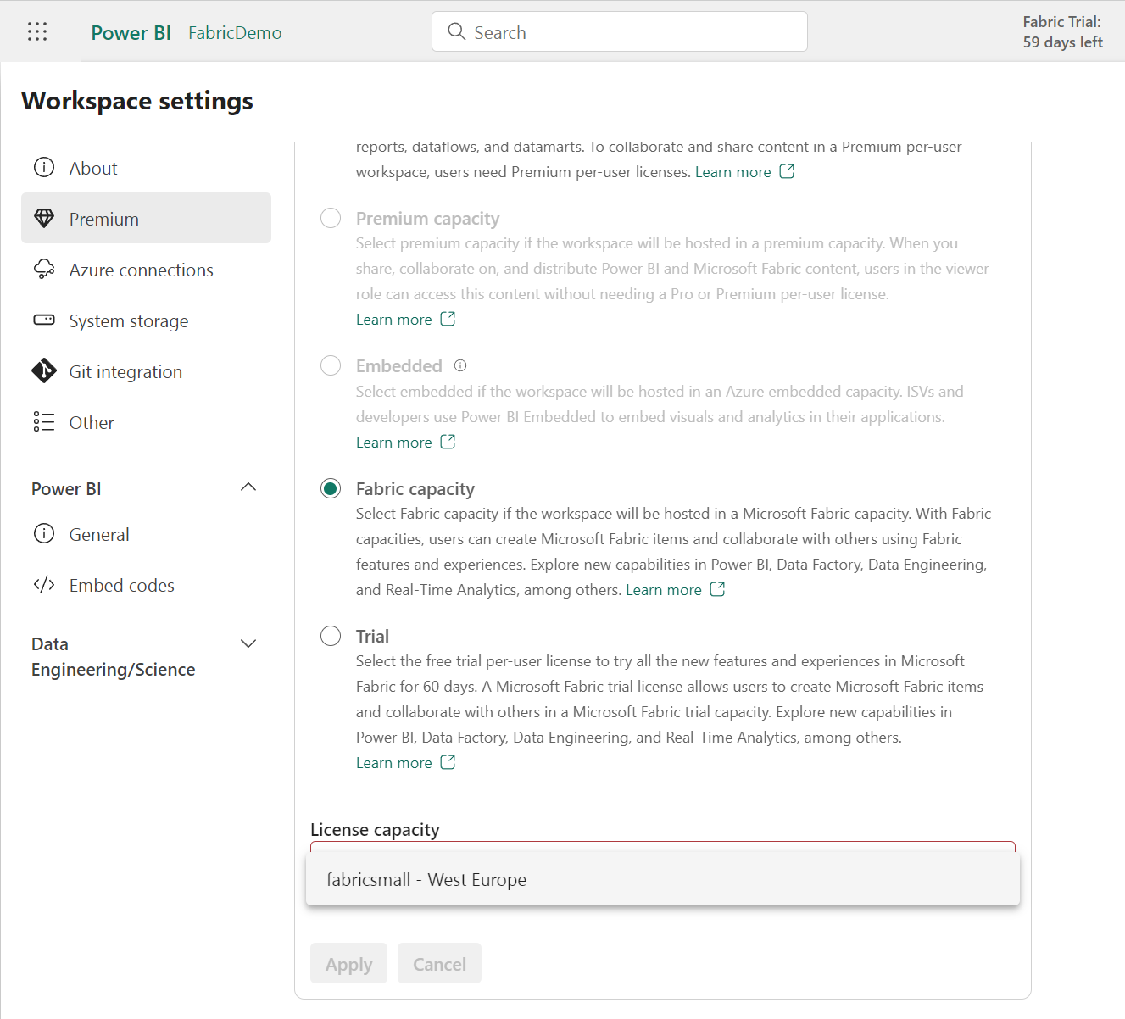
PowerBI Admin page
App.powerbi.com
Workspace Settings
Premium
Notes:
Assign a license in PBI Admin page

Slide 10
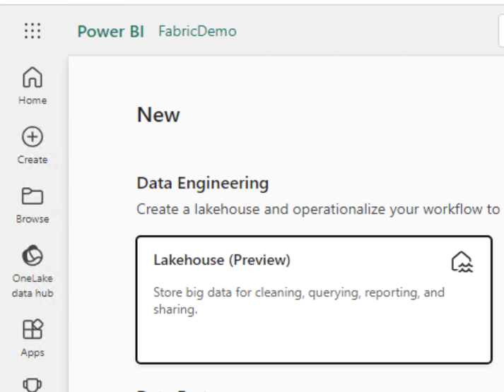
Create Lakehouse

Slide 11
Data files used
Azure subscription usage details
Adventure Works sample Excel
https://github.com/microsoft/powerbi-desktop-samples/tree/main/AdventureWorks%20Sales%20Sample

Slide 12
Dataset restrictions
Remove spaces from column names
Invalid column name(s) 'Sales Order, Sales Order Line'. Column names must contain UTF-8 encoded Unicode word characters and can be a maximum of 128 characters long. Unicode word characters include letters of any case and their nonspacing marks, punctuation connectors like the underscore(_), and decimal digits.

